Slide 1
Silly scenarios

Slide 2
Scenario 1
Base scenario

Slide 3
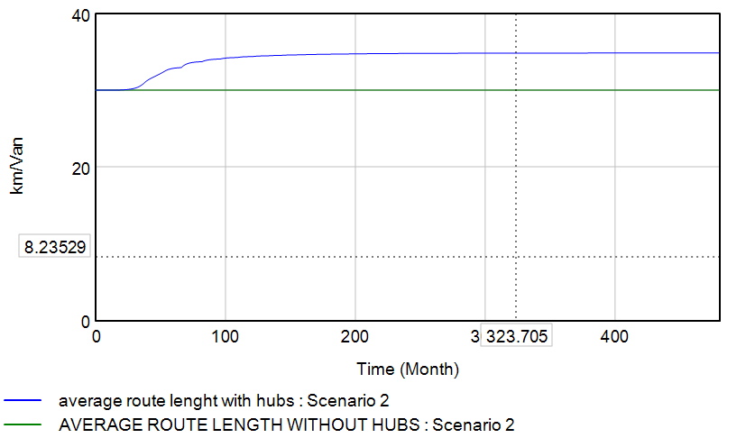
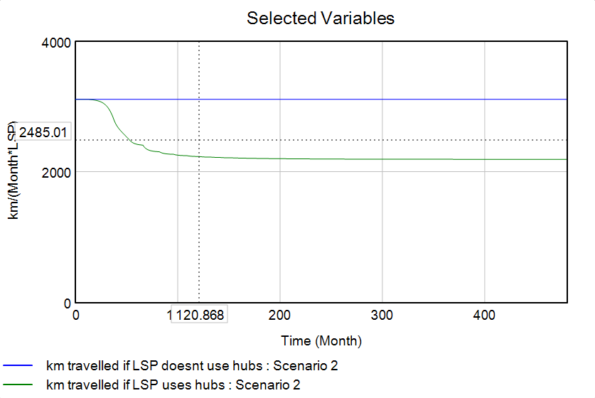
Scenario 2
Tried with all three „efficiencies“ – what if the maximum efficiency is lower than the current efficiency?

Slide 4
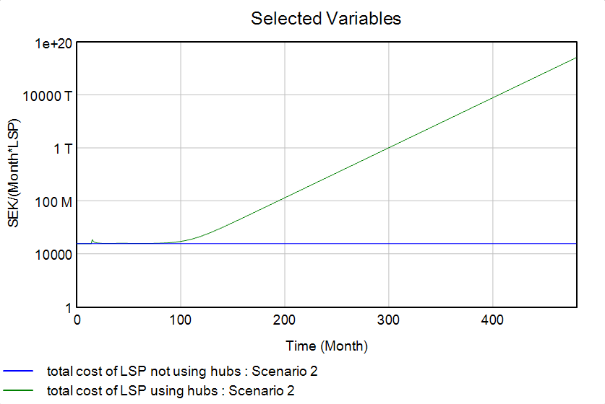
Scenario 2
Reason for exponential behaviour:
LSP adopters are -> 0
But if we do this for all three…

Slide 5
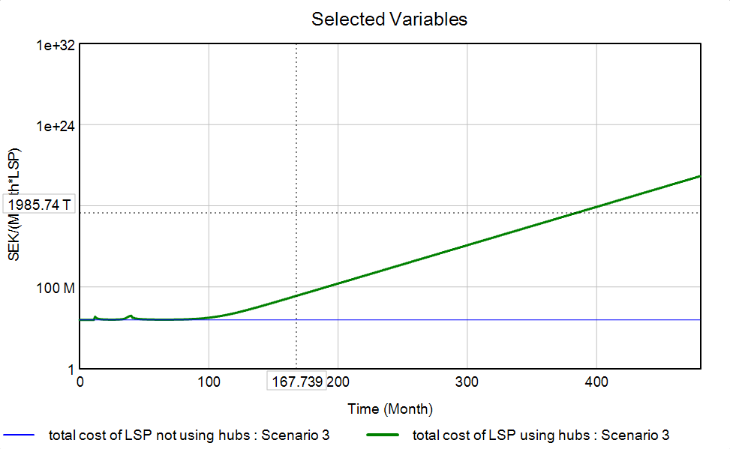
Scenario 3
We obtain the exact same result of costs if we assume a negative effect of city hubs on the efficiencies
„multipliers“ are set to -0.5

Slide 6
Scenario 4
Capacity of the hub = 0
Cost of the hub = 0

Slide 7
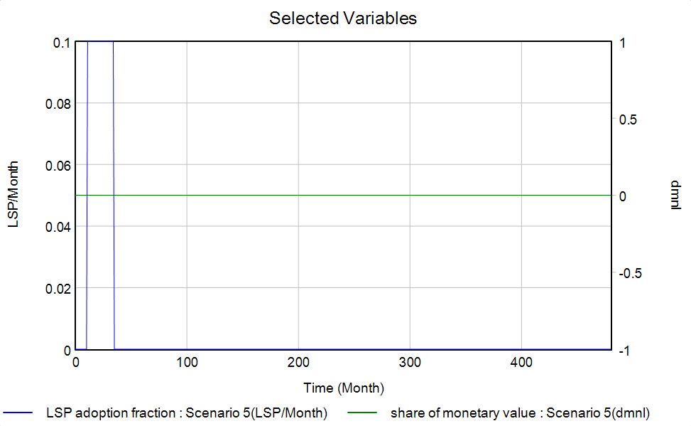
Scenario 5
If all costs are zero –> not really useful to join hubs

Slide 8
Scenario 5
If we make all costs zero but the monthly cost of hubs
The problem lies in the definition of the „share of monetary value“

Slide 9
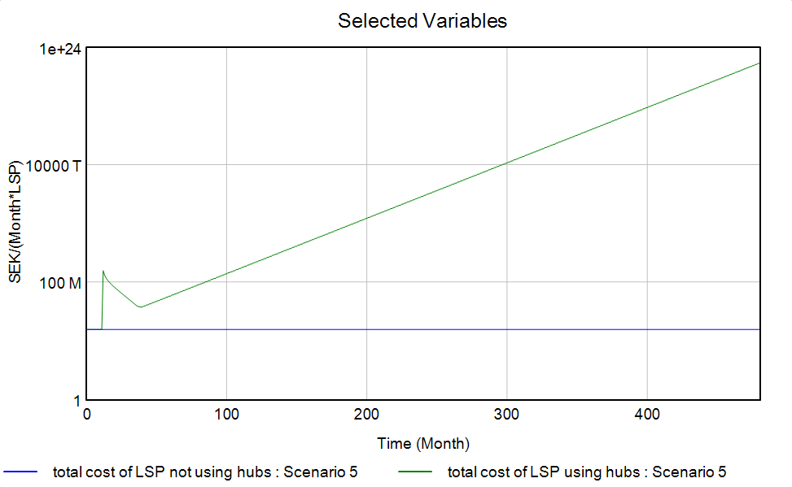
Scenario 5
If we return to having the costs not zero and we just modify the cost of hubs and we make it really high we achieve the scenario where the hub system doesn‘t work

Slide 10
Scenario 6
We need more LSP to be on board to make the system profitable -> by increasing the number of LSP we decrease the „share of demand“ that each LSP has (compared to the total) and therefore we need more on board.
LSP = 0 gives error „divide by zero“
LSP = 1 works well
LSP = 10M works only if we increase the push time

